Slide 1
CSC2211 ALGORITHMS
SORTING
Sarwar
Faculty, Department of Computer Science
American International University-Bangladesh (AIUB)
msjmo@aiub.edu
Sarwar Morshed
CSC 2211: Algorithms

Slide 2
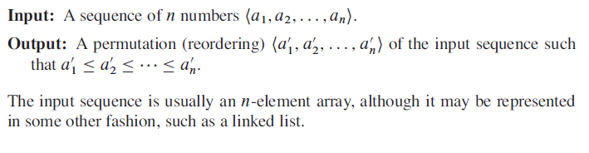
Sorting Problem:
Structure of Data: Records, Satellite Data
Sorting Algorithm: Describe the Method by which we determine the Sorted Order
Sarwar Morshed
CSC 2211: Algorithms
Introduction→<number>

Slide 3
WHY SORTING?
Some Application Inherently needs to sort information
Many Algorithm use Sorting as Key Subroutine
Variety of Sorting Algorithm, employee rich set of techniques
Sorting Algorithms are automatically optimal (Upper Bound-Lower Bound Match[Asymp..])
Engineering Issues when implementing Sorting Algorithms
Sarwar Morshed
CSC 2211: Algorithms
Introduction→<number>

Slide 4
QuickSort
• Proposed by C.A.R. Hoare in 1962.
• Divide-and-conquer algorithm.
• Sorts “in place” (like insertion sort, but not like merge sort).
• Very practical (with tuning).
Small Constant factor hidden
Worst Case ? Average Case?
Sarwar Morshed
CSC 2211: Algorithms
Introduction→<number>

Slide 5
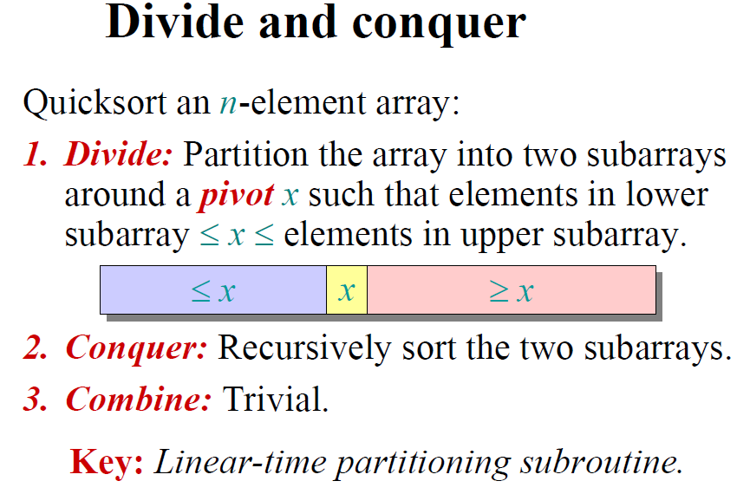
Sarwar Morshed
CSC 2211: Algorithms
Introduction→<number>

Slide 6
STEPS OF QUICK SORT
Pick an element, called a pivot, from the array.
Reorder the array so that all elements with values less than the pivot come before the pivot, while all elements with values greater than the pivot come after it (equal values can go either way). After this partitioning, the pivot is in its final position. This is called the partition operation.
Recursively apply the above steps to the sub-array of elements with smaller values and separately to the sub-array of elements with greater values.
Sarwar Morshed
CSC 2211: Algorithms
Introduction→<number>

Slide 7
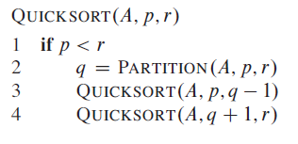
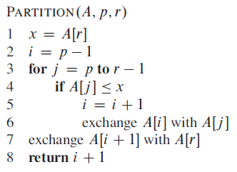
Sarwar Morshed
CSC 2211: Algorithms
Introduction→<number>

Slide 8
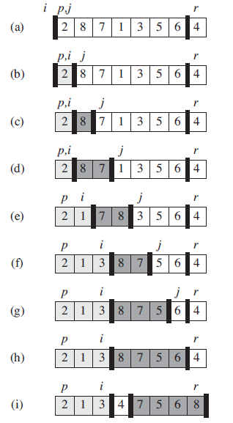
Sarwar Morshed
CSC 2211: Algorithms
Introduction→<number>

Slide 9
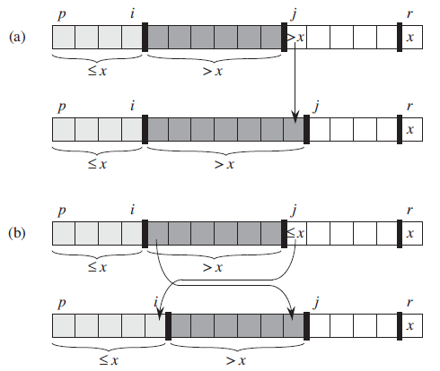
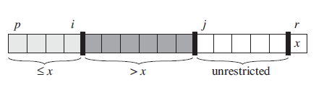

Loop invariant
Sarwar Morshed
CSC 2211: Algorithms
Introduction→<number>

Slide 10
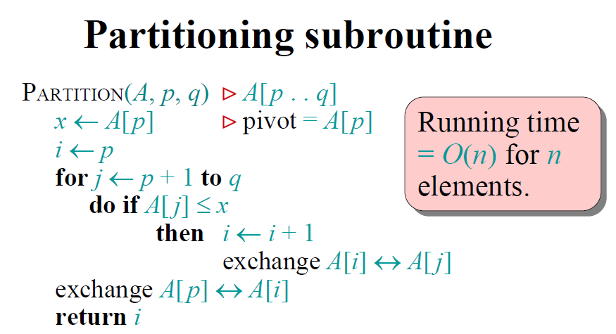
Sarwar Morshed
CSC 2211: Algorithms
Introduction→<number>

Slide 11
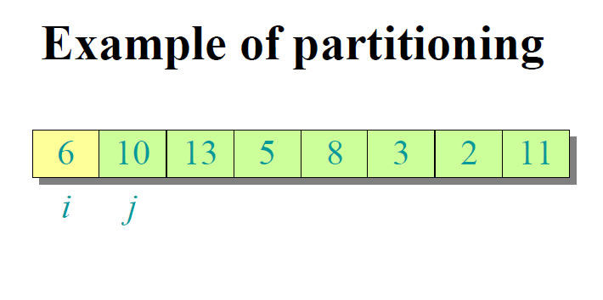
Sarwar Morshed
CSC 2211: Algorithms
Introduction→<number>

Slide 12
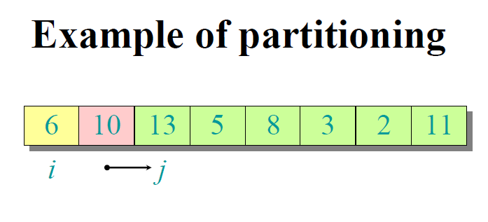
Sarwar Morshed
CSC 2211: Algorithms
Introduction→<number>

Slide 13
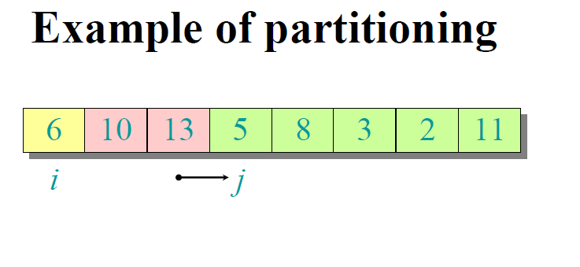
Sarwar Morshed
CSC 2211: Algorithms
Introduction→<number>

Slide 14
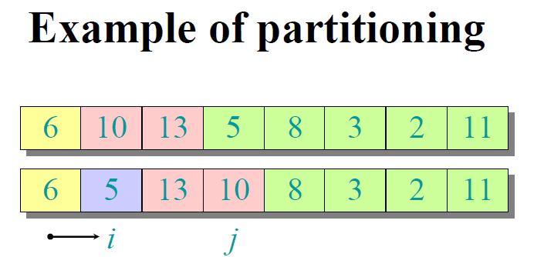
Sarwar Morshed
CSC 2211: Algorithms
Introduction→<number>

Slide 15
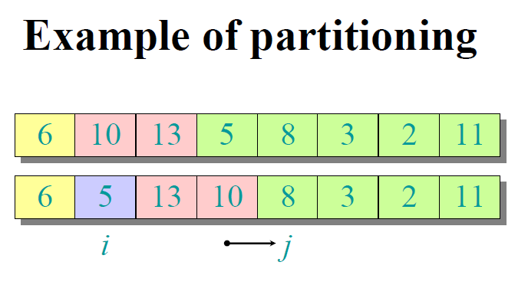
Sarwar Morshed
CSC 2211: Algorithms
Introduction→<number>

Slide 16
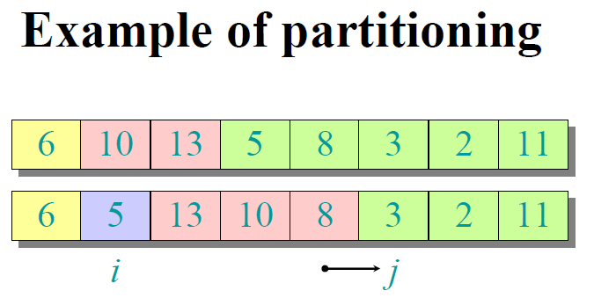
Sarwar Morshed
CSC 2211: Algorithms
Introduction→<number>

Slide 17
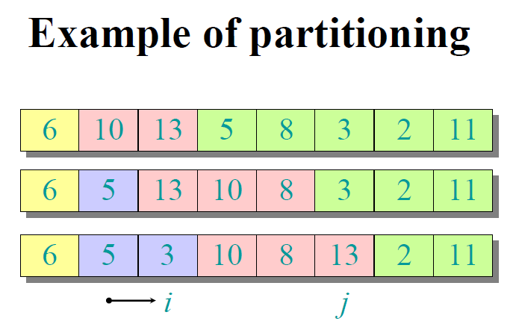
Sarwar Morshed
CSC 2211: Algorithms
Introduction→<number>

Slide 18
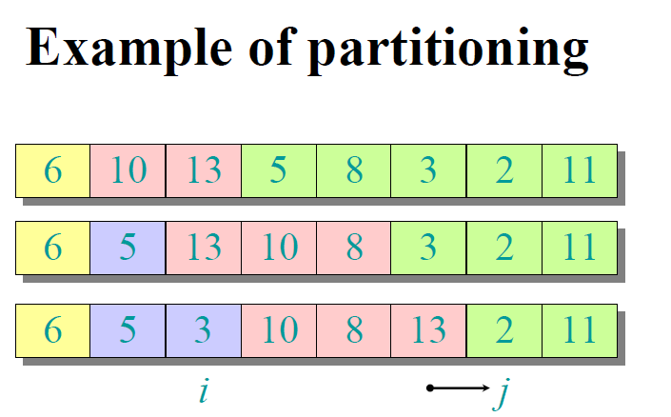
Sarwar Morshed
CSC 2211: Algorithms
Introduction→<number>

Slide 19
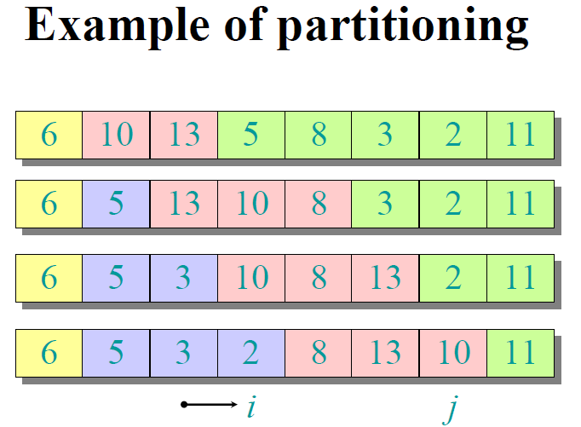
Sarwar Morshed
CSC 2211: Algorithms
Introduction→<number>

Slide 20
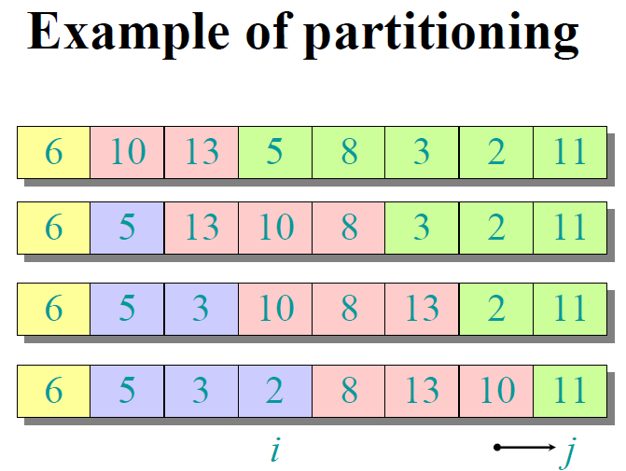
Sarwar Morshed
CSC 2211: Algorithms
Introduction→<number>

Slide 21
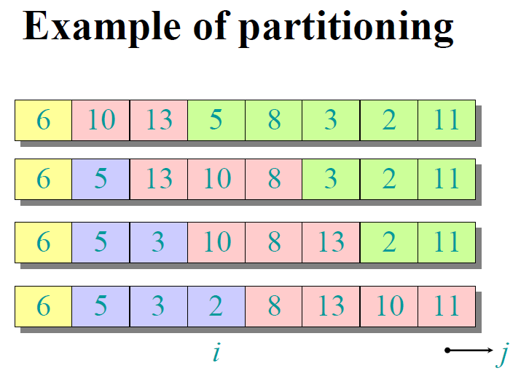
Sarwar Morshed
CSC 2211: Algorithms
Introduction→<number>

Slide 22
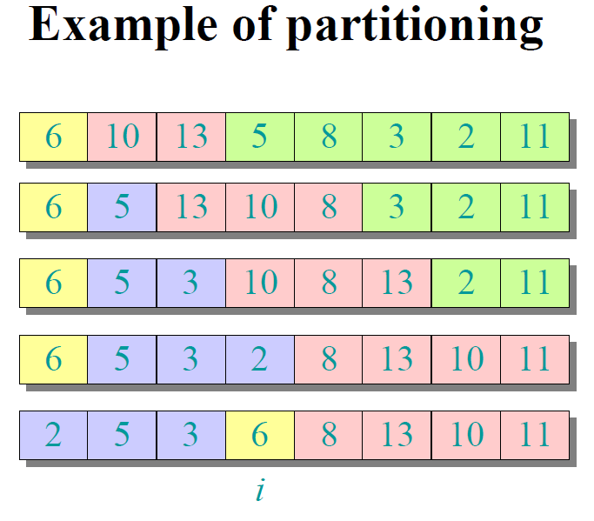
Sarwar Morshed
CSC 2211: Algorithms
Introduction→<number>

Slide 23
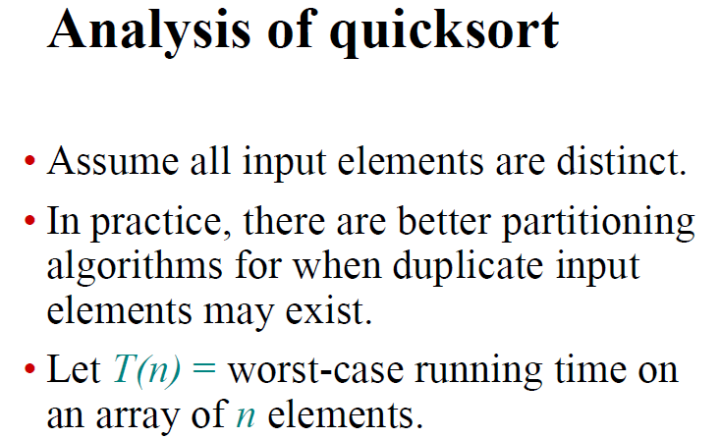
Sarwar Morshed
CSC 2211: Algorithms
Introduction→<number>

Slide 24
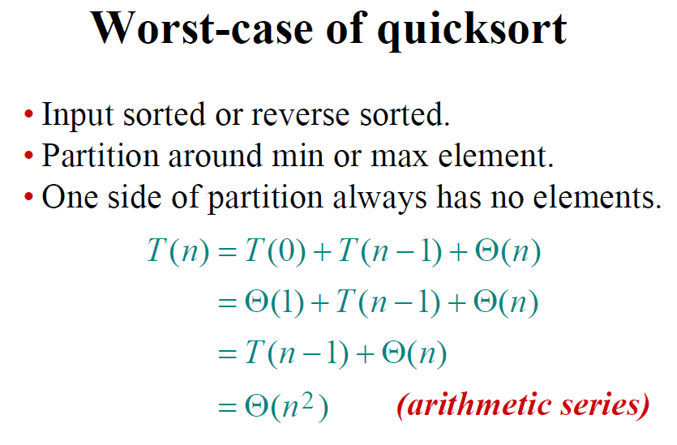
Sarwar Morshed
CSC 2211: Algorithms
Introduction→<number>

Slide 25
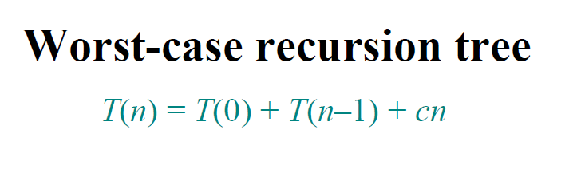
Sarwar Morshed
CSC 2211: Algorithms
Introduction→<number>

Slide 26
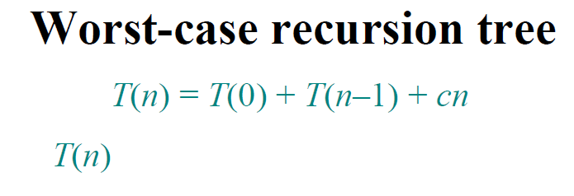
Sarwar Morshed
CSC 2211: Algorithms
Introduction→<number>

Slide 27
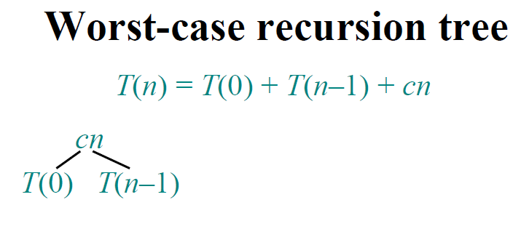
Sarwar Morshed
CSC 2211: Algorithms
Introduction→<number>

Slide 28
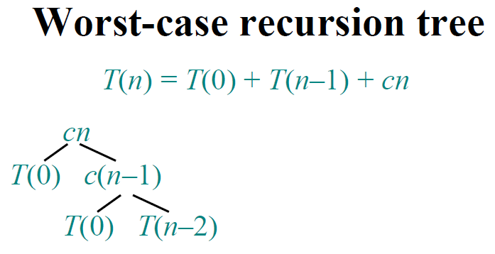
Sarwar Morshed
CSC 2211: Algorithms
Introduction→<number>

Slide 29
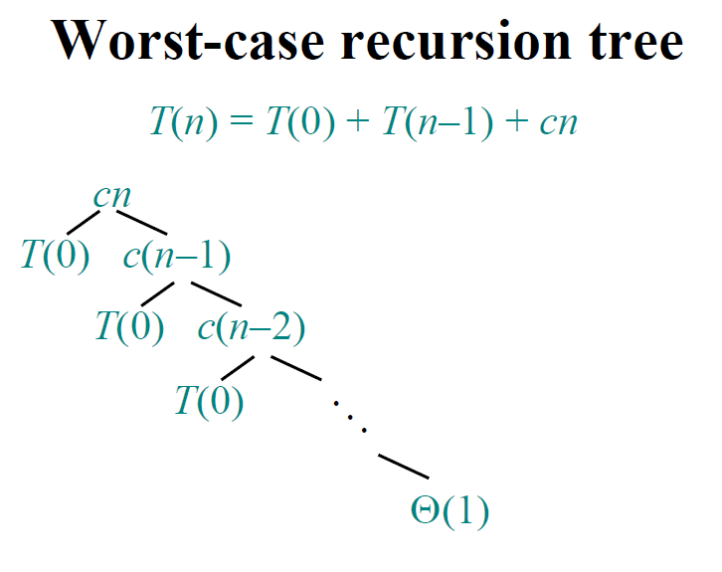
Sarwar Morshed
CSC 2211: Algorithms
Introduction→<number>

Slide 30
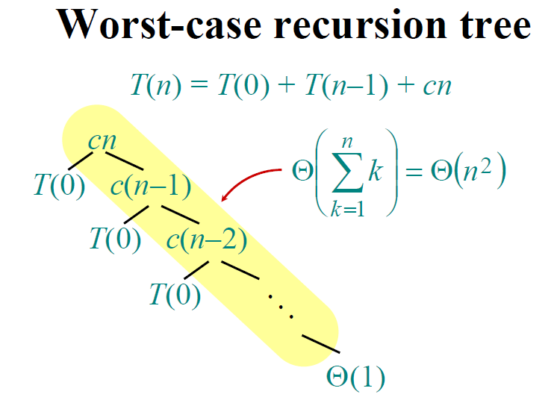
Sarwar Morshed
CSC 2211: Algorithms
Introduction→<number>

Slide 31
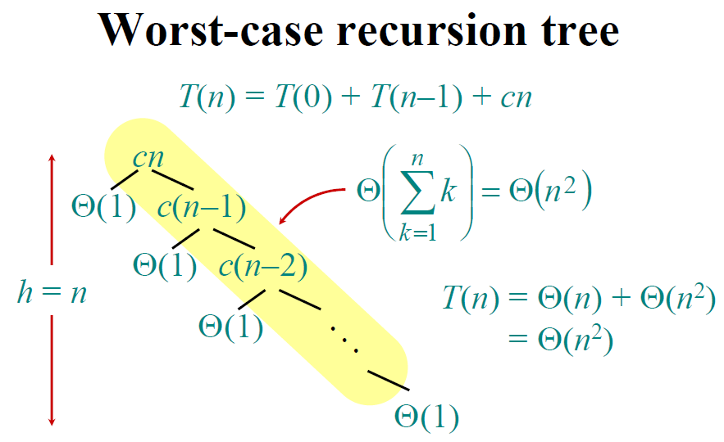
Sarwar Morshed
CSC 2211: Algorithms
Introduction→<number>

Slide 32
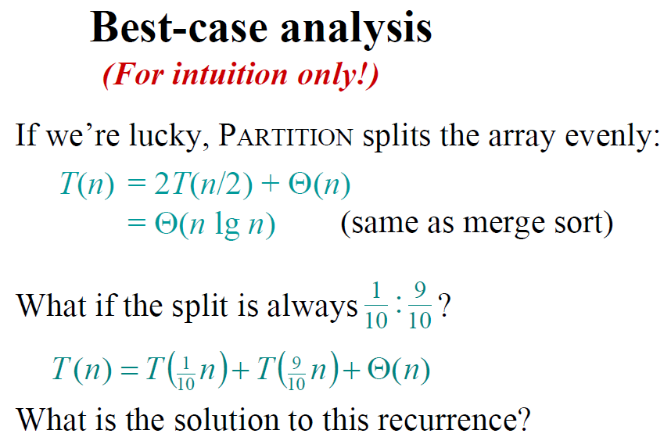
Sarwar Morshed
CSC 2211: Algorithms
Introduction→<number>

Slide 33
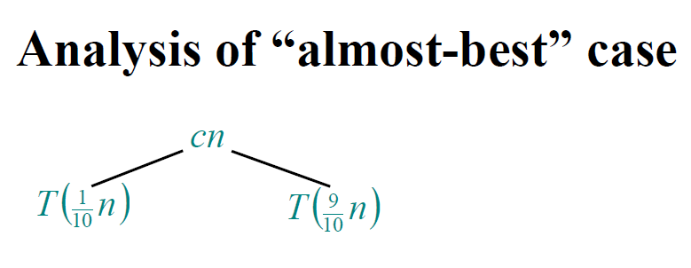
Sarwar Morshed
CSC 2211: Algorithms
Introduction→<number>

Slide 34
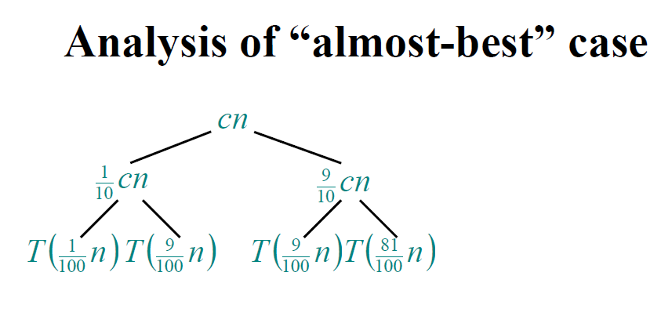
Sarwar Morshed
CSC 2211: Algorithms
Introduction→<number>

Slide 35
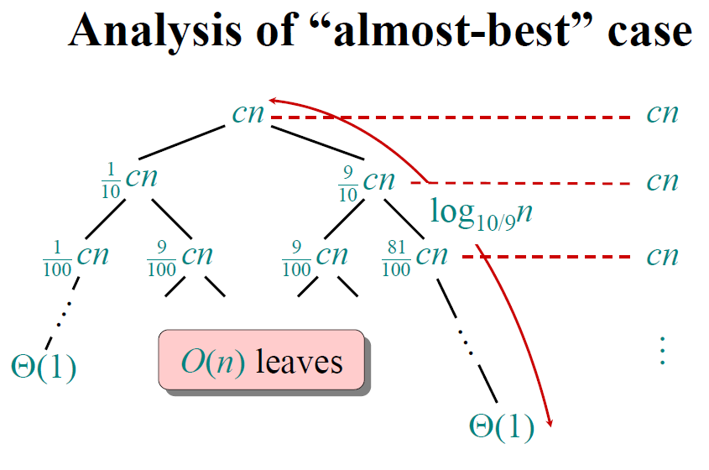
Sarwar Morshed
CSC 2211: Algorithms
Introduction→<number>

Slide 36
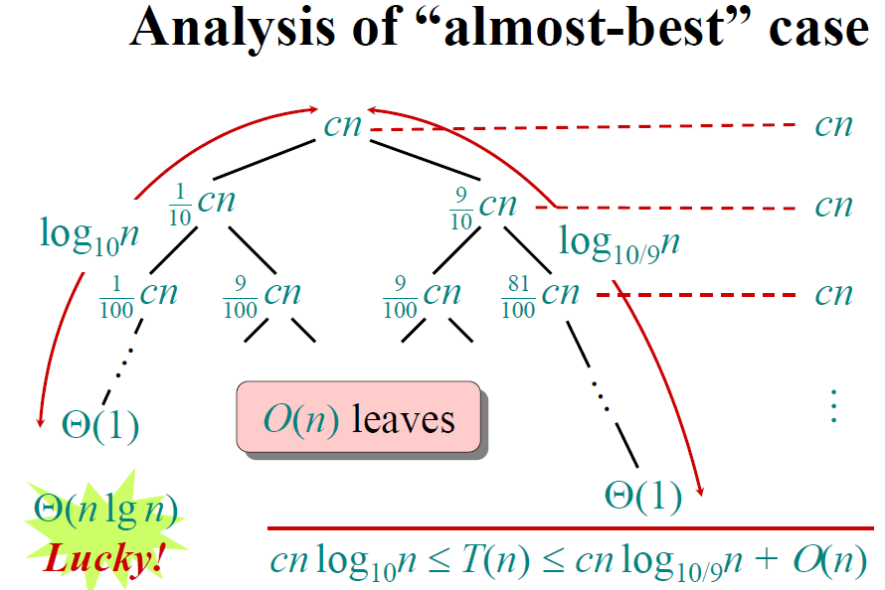
Sarwar Morshed
CSC 2211: Algorithms
Introduction→<number>

Slide 37
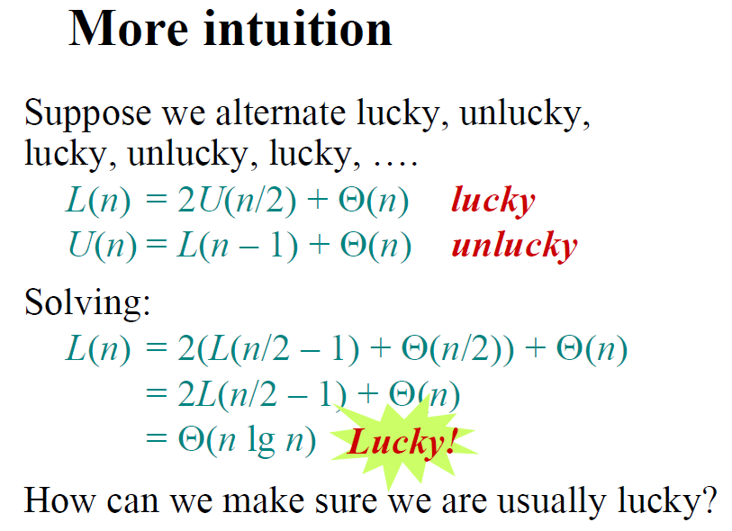
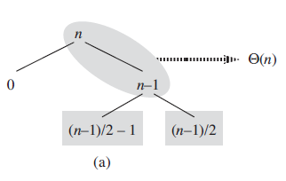
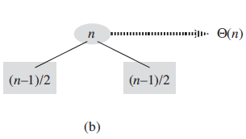
Sarwar Morshed
CSC 2211: Algorithms
Introduction→<number>

Slide 38
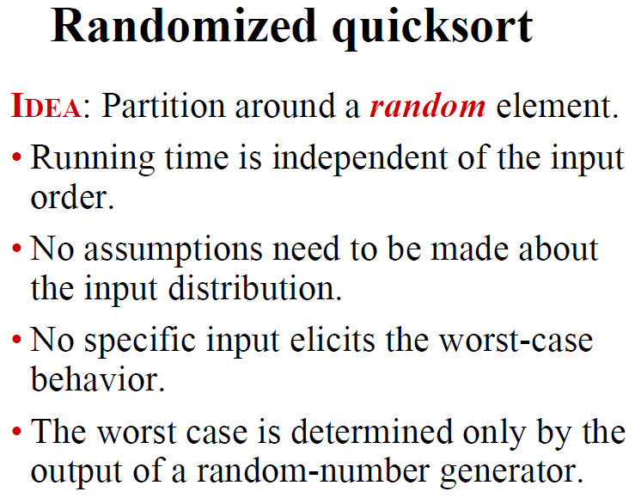
Sarwar Morshed
CSC 2211: Algorithms
Introduction→<number>

Slide 39
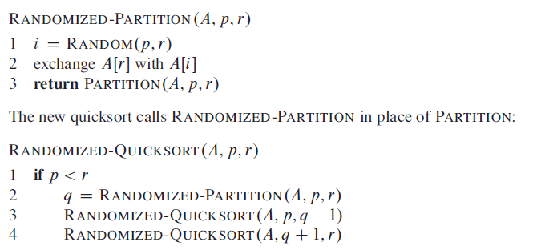
Sarwar Morshed
CSC 2211: Algorithms
Introduction→<number>

Slide 40
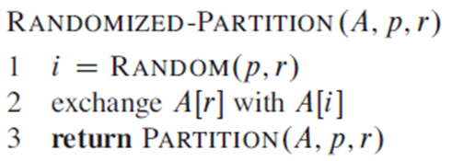
RUNNING TIME AND COMPARISONS
Sarwar Morshed
CSC 2211: Algorithms
Introduction→<number>

Slide 41
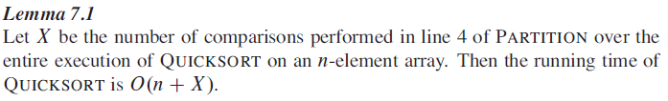

Sarwar Morshed
CSC 2211: Algorithms
Introduction→<number>

Slide 42
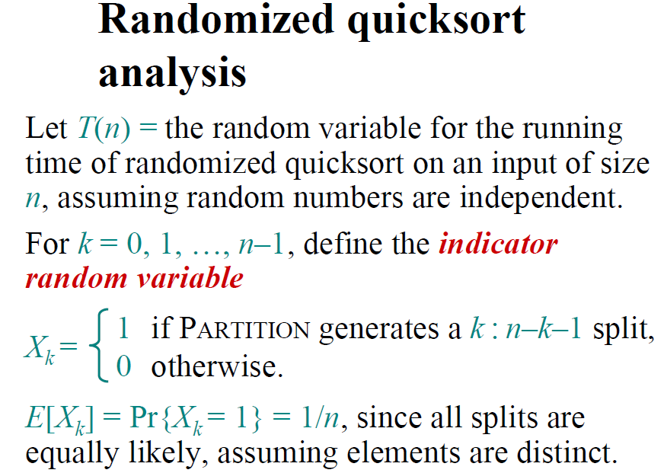
Sarwar Morshed
CSC 2211: Algorithms
Introduction→<number>

Slide 43

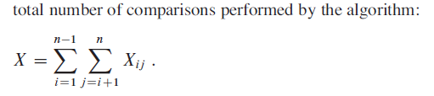

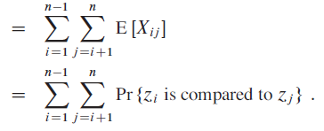

Sarwar Morshed
CSC 2211: Algorithms
Introduction→<number>

Slide 44
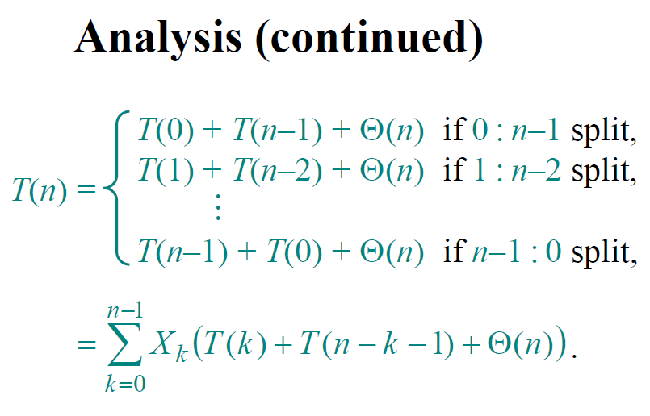
Sarwar Morshed
CSC 2211: Algorithms
Introduction→<number>

Slide 45
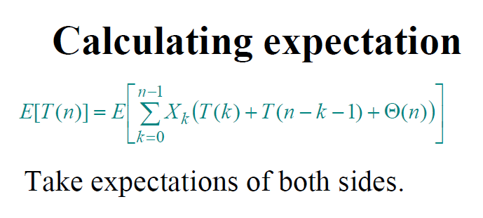
Sarwar Morshed
CSC 2211: Algorithms
Introduction→<number>

Slide 46
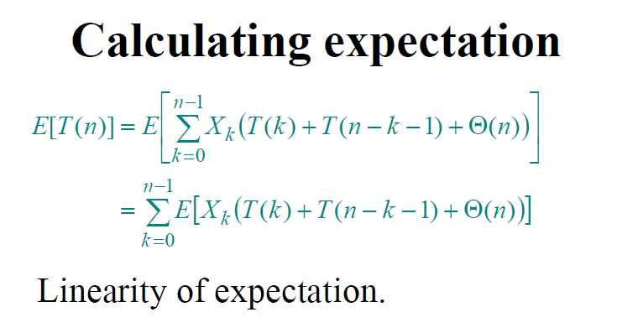
Sarwar Morshed
CSC 2211: Algorithms
Introduction→<number>

Slide 47
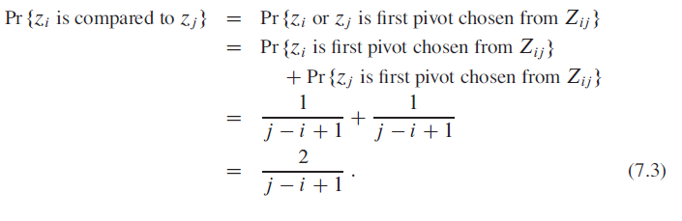
Sarwar Morshed
CSC 2211: Algorithms
Introduction→<number>

Slide 48
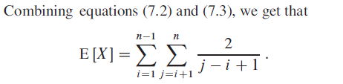
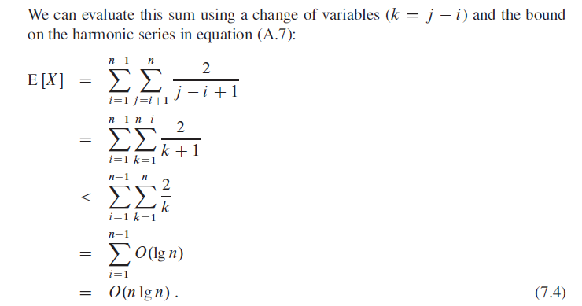

Sarwar Morshed
CSC 2211: Algorithms
Introduction→<number>

Slide 49

Sarwar Morshed
CSC 2211: Algorithms
Introduction→<number>

